Slide 1
Pure strategy game theory
Your outcomes in the world don’t just depend on your own actions
Other people around you are also making decisions/actions that affect you
Our goal: Find the pairs of actions where no one wants to change their mind
We think about this as every player being at their local and individual optimal point
Compare this to the monopoly maximizing profit, where the monopoly is at the global optimal point
We call these points Nash Equilibria

Slide 2


Pure strategy game theory
It’s useful to think about the questions are asking, and those we aren’t asking
We are asking: What are the pairs of decisions so that no individual would want to deviate? That is, what are the Nash Equilibria?
We are not asking: How do I know that the other player is playing its Nash Equilibrium strategy?
We are not asking: If there are multiple Nash Equilibria, which one should I choose?
We are not asking: How do I even know what the other player’s payoffs are?
These are all interesting questions – but in this course we’re really just focused on finding the Nash Equilibria

Slide 3
Pure strategy game theory
How do we find Nash Equilibria
Start with our payoff matrix
Set Player 2’s decision to play option 1: What is the best decision Player 1 could make?
Set Player 2’s decision to play option 2: What is the best decision Player 1 could make?
Do the same, switching Player 1 and Player 2
Where the best decisions point to the same cell, this is a Nash Equilibrium – it means that both players’ best decisions should end up in the same place. Neither player would want to make a different decision
The arrows we draw encode the Best Response function of each player

Slide 4
Our firm entry game from last lecture
 | Firm 1 enters | Firm 1 does not enter
Firm 2 enters | F1 profit = -1 F2 profit = -1 | F1 profit = 0 F2 profit = 1
Firm 2 does not enter | F1 profit = 1 F2 profit = 0 | F1 profit = 0 F2 profit = 0

Slide 5
Mixed strategy game theory
Often the optimal play for you to make is randomizing your moves
This is true in many real-life games:
In poker, there is a game-theory optimal portion of the time that you should bluff rather than fold. If you don’t randomize correctly, other players can get an edge over you
In soccer, there is a game-theory optimal portion of the time you should kick a penalty to the right rather than the left. If you don’t randomize correctly, the goalie can save it more often than not
In these settings, players often know they are playing these games and they do actually play their equilibrium mixed strategies
Here, our Nash Equilibria are when both players want to randomize

Slide 6
Mixed strategy game theory
Again, it’s useful to think about the questions are asking, and those we aren’t asking
We are asking: What are the probabilities both players should make decisions so that both players want to keep randomizing?
We are not asking: How do I know the other player is not just playing a pure strategy game – that is, not randomizing?
We are not asking: How do I know the other player is randomizing correctly?
We are not asking: How do I even know the other player’s probabilities they are using?
These are all interesting questions – but in this course we’re really just focused on finding the mixed Nash Equilibrium probabilities

Slide 7
Mixed strategy game theory
Let’s have a thought experiment of why these mixed strategies arise
Imagine a casino is designing a new roulette game where red or black is chosen randomly
The gambler is going to play this game by also choosing red or black randomly
If the gambler chooses correctly, they win. The winner gets $1, the loser loses $1
Two key questions:
With what probability should the casino game show red or black?
With what probability should the gambler choose red or black?
Let’s reason through this, before solving it properly

Slide 8
Mixed strategy game theory
1 - With what probability should the casino game show red or black?
If the casino game shows red 75% of the time:
The gambler should always choose red because they have a 75% chance of winning
The gambler gets an edge here and would not randomize (not a NE!)
If the casino game shows red 25% of the time:
The gambler should always choose black because they have a 75% chance of winning
The gambler gets an edge here and would not randomize (not a NE!)
If the casino game shows red 50% of the time:
The gambler should be indifferent between choosing black or red, there’s no edge they can gain
The casino game having red pop up 50% is part of the mixed strategy Nash Equilibrium

Slide 9
Mixed strategy game theory
2 - With what probability should the gambler choose red or black?
If the gambler chooses red 75% of the time
The casino should design their game to always show black because they have a 75% chance of winning
The casino gets an edge here and would not randomize (not a NE!)
If the gambler chooses red 25% of the time
The casino should design their game to always show red because they have a 75% chance of winning
The casino gets an edge here and would not randomize (not a NE!)
If the gambler chooses red 50% of the time
The casino should be indifferent between their game showing black or red, there’s no edge they can gain
The gambler choosing red 50% of the time is part of the mixed strategy Nash Equilibrium

Slide 10
Mixed strategy game theory
So for our mixed strategy Nash Equilibrium, we have two conditions that need to happen at once!
1 - The casino game having red pop up 50% is part of the mixed strategy Nash Equilibrium
2 - The gambler choosing red 50% of the time is part of the mixed strategy Nash Equilibrium
If either the gambler or casino plays even slightly different probabilities, the other player gets an edge and would not longer randomize
I like to think of our mixed strategies as the probabilities that hold everything in this nice, delicate balance. Even small deviations completely unravel the randomization

Slide 11
Let’s solve our casino game properly
 | Casino: Red | Casino: Black
Gambler: Red | C = -1 G = 1 | C = 1 B = -1
Gambler: Black | C = 1 G = -1 | C = -1 B = 1
Probability that roulette game chooses red = p_{C}
Probability that roulette game chooses red = (1 – p_{C)}
Probability that gambler chooses red = p_{G}
Probability that gambler chooses black = (1 – p_{G})

Slide 12
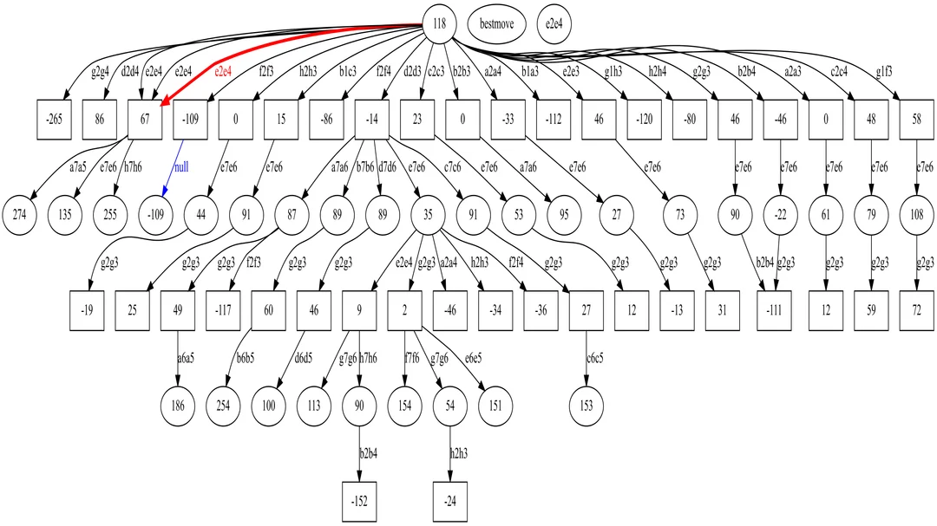
Sequential games and first mover advantage
Our games up to now (simultaneous games) rely on each player responding to each other
But when Player 1 goes first, they typically get an advantage – only Player 2 has to respond to Player 1
Player 1 gets the advantage of anticipating Player 2’s best moves
We solve all of the small, subsets of decisions bottom to top to find Player 1’s optimal opening moves!
This is literally what chess engines (and chess players!) do when playing games

Slide 13
1
Attack the Queen
Attack the King
2
2
Counter
attack
Defend
Counter
attack
Defend
1
1
1
1: +1,000
2: -1,000
Counter
attack
Defend
Counter
attack
Defend
Counter
attack
Defend
1: +10
2: -10
1: +5
2: -5
1: -15
2: +10
1: 0
2: 0
1: +20
2: -20
1: +5
2: -5

Slide 14
Lastly, our models of competition
The purpose of our models of competition is to use our tools of game theory to think about how firms compete
Three models:
Cournot: Firms compete on choosing quantity/output
Bertrand: Firms compete on choosing prices
Stackelberg: Firm 1 chooses output first, then Firm 2 responds
All variations on the same theme:
We want to find the mathematical conditions when all firms are profit maximizing
If all firms are profit maximizing, no firm wants to change its strategy – so we have a Nash Equilibrium!

Slide 15
Our mathematical conditions
 | Firm 1 | Firm 2
Cournot game | Profit is a function of q₁ and q₂ Maximise with respect to q₁ Find best response function: q₁ = A – Bq₂ | Profit is a function of q₁ and q₂ Maximise with respect to q₂ Find best response function: q₂ = A – Bq₁
Bertrand game | Profit is a function of p₁ and p₂ Maximise with respect to p₁ Find best response function: p₁ = A + Bp₂ | Profit is a function of p₁ and p₂ Maximise with respect to p₂ Find best response function: p₂ = A + Bp₁
Stackelberg game with Firm 1 going first | Profit is a function of q₁ only! (Substituting in Firm 2’s BR function) Maximise with respect to q₁ | Profit is a function of q₁ and q₂ Maximise with respect to q₂ Find best response function: q₂ = A – Bq₁

Slide 16
1
Attack the Queen
Attack the King
2
2
Counter
attack
Defend
Counter
attack
Defend
1
1
1
1: +1,000
2: -1,000
Counter
attack
Defend
Counter
attack
Defend
Counter
attack
Defend
1: +10
2: -10
1: +5
2: -5
1: -15
2: +10
1: 0
2: 0
1: +20
2: -20
1: +5
2: -5

Slide 17
 | Casino: Red | Casino: Black
Gambler: Red | C = -1 G = 1 | C = 1 G = -1
Gambler: Black | C = 1 G = -1 | C = -1 G = 1
Probability that roulette game chooses red = p_{C}
Probability that roulette game chooses red = (1 – p_{C)}
Probability that gambler chooses red = p_{G}
Probability that gambler chooses black = (1 – p_{G})

